Slide 1
Value-Added Training CESA SIS
May 2012

Slide 2
Agenda
Wisconsin’s use of VA for Educator Effectiveness
Oak Tree Analogy Expansion
Break
Report Interpretation and Decision Making
Sample Report Review
Implications for CESAs, Q&A, Wrap-Up

Slide 3
Educator Effectiveness
Brad Carl

Slide 4
DPI Educator Effectiveness
Phase I: Design Team report November 2011
Year-long process of engagement among stakeholder organizations to develop vision for new system of teacher & principal evaluation in WI

Slide 5
DPI Educator Effectiveness
Phase II: Four work groups convened to develop more detailed process to match principles outlined in Phase I:
Teacher Practice
Principal Practice
Student Learning Objectives
Data Systems/Data Quality
A related, cross-cutting area of work will involve further development of district assessment data and combining these measures into formative and summative ratings

Slide 6
Educator Effectiveness Timeline *
Stage 1 Developing
Stage 2 Piloting
Stage 3 Implementing
Framework released
Model development
Developmental districts
Voluntary Pilots
Development work
Evaluator and educator training
System training
Pilot evaluation
Model revisions
Training continued
Statewide implementation strategy
Educator effectiveness system implemented statewide
2011-12
2012-13
2013-14
2014-15
Continuous Improvement
*All work contingent on funding and resources

Slide 7
System Weights
50%
Student Growth
50%
Educator Practice

Slide 8
Models of Practice Detail (50% of evaluation)
50%
Student Growth
50%
Educator Practice
Teacher
InTASC (Danielson or equivalency review)
Principal
ISLLC

Slide 9
Student Outcome Detail (50% of evaluation)
Models of Practice
Student Learning Objectives
District Choice

Slide 10
Student Outcome Weights (PK-8)
State assessment, district assessment, SLOs, and other measures
SLOs and other measures
Notes:
SLOs only (neither state nor districtwide assessments, for example -a music teacher):
PK–8: 90% SLOs, 5% schoolwide reading and 5% district choice
9–12: 90% SLOs, 5% graduation rate, and 5% district choice

Slide 11
Student Outcome Weights (9-12)
State assessment, district assessment, SLOs, and other measures
SLOs
Notes:
PK–8: 90% SLOs, 5% schoolwide reading and 5% district choice
9–12: 90% SLOs, 5% graduation rate, and 5% district choice

Slide 12
Educator Effectiveness System Matrix
 | Student Outcomes
Models of Practice |  | 1 | 2 | 3 | 4 | 5
 | 1 |  |  |  | * | *
 | 2 |  |  |  |  | *
 | 3
 | 4 | *
 | 5 | * | *
Asterisks indicate a mismatch between educator’s practice performance and student outcomes and requires
a focused review to determine why the mismatch is occurring and what, if anything, needs to be corrected.

Slide 13
Oak Tree Analogy Expansion
Sean McLaughlin

Slide 14
The Oak Tree Analogy Review
Notes:
This Oak Tree Analogy was created to introduce the concept of value added calculations. It is not in the education context in an attempt to keep this overview of the theory of value added separate from details specific to its use in education.

Slide 15
Method 1: Measure the Height of the Trees Today (One Year After the Gardeners Began)
Using this method, Gardener B is the more effective gardener.
This method is analogous to using an Achievement Model.
Gardener A
72 in.
Gardener B
61 in.
Notes:
To measure the performance of the gardeners, we will measure the height of the trees today, 1 year after they began tending to the trees.
With a height of 61 inches for Oak Tree A and 72 inches for Oak Tree B, we find Gardener B to be the better gardener.
This method is analogous to using an achievement Model to evaluate performance.

Slide 16
Method 2: Compare Starting Height to Ending Height
Oak B had more growth this year, so Gardener B is the more effective gardener.
This is analogous to a Simple Growth Model, also called Gain.
Gardener A
+20 in.
72 in.
Gardener B
+14 in.
61 in.
52 in.
47 in.
Oak A
Age 3
(1 year ago)
Oak A
Age 4
(Today)
Oak B
Age 3
(1 year ago)
Oak B
Age 4
(Today)
Notes:
We can compare the height of the trees one year ago to the height today.
By finding the difference between these heights, we can determine how many inches the trees grew during the year of gardener’s care.
By using this method, Gardener A’s tree grew 14 inches while Gardener B’s tree grew 20 inches. Oak B had more growth this year, so Gardener B is the better gardener.
This is analogous to using a Simple Growth Model, also called Gain.

Slide 17
Controlling for Non-Gardener Factors
The predicted height for trees in Oak A’s conditions is 59 inches.
The predicted height for trees in Oak B’s conditions is 74 inches.
74 in.
Gardener A
Gardener B
59 in.
52 in.
47 in.
+20 Average
+20 Average
+ 3 for Rainfall
- 5 for Rainfall
- 3 for Soil
+ 2 for Soil
- 8 for Temp
+ 5 for Temp
_________
+12 inches
During the year
Predicted
Oak A
Predicted
Oak B
_________
+22 inches
During the year
Notes:
Now that we have refined our predictions based on the effect of environmental conditions, our gardeners are on a level playing field.
The predicted height for trees in Oak A’s conditions is 59 inches.
The predicted height for trees in Oak B’s conditions is 74 inches.

Slide 18
Method 3: Compare the Predicted Height to the Actual Height
By accounting for last year’s height and environmental conditions of the trees during this year, we found the “value” each gardener “added” to the growth of the trees.
This is analogous to a Value-Added measure.
-2
74 in.
72 in.
Gardener A
+2
Gardener B
61 in.
59 in.
Above
Average
Value-Added
Below
Average
Value-Added
Predicted
Oak A
Actual
Oak A
Predicted
Oak B
Actual
Oak B
Notes:
Using this method, Gardener A is the superior gardener.
By accounting for last year’s height and environmental conditions of the trees during this year, we have found the “value” each gardener “added” to the growth of the tree.
This is analogous to a value added measure.

Slide 19
Oak Tree Additions
What about tall or short trees?
(high or low achieving students)
How does VARC choose what to control for?
(proxy measurements for causal factors)
What if a gardener just gets lucky or unlucky?
(groups of students and confidence intervals)

Slide 20
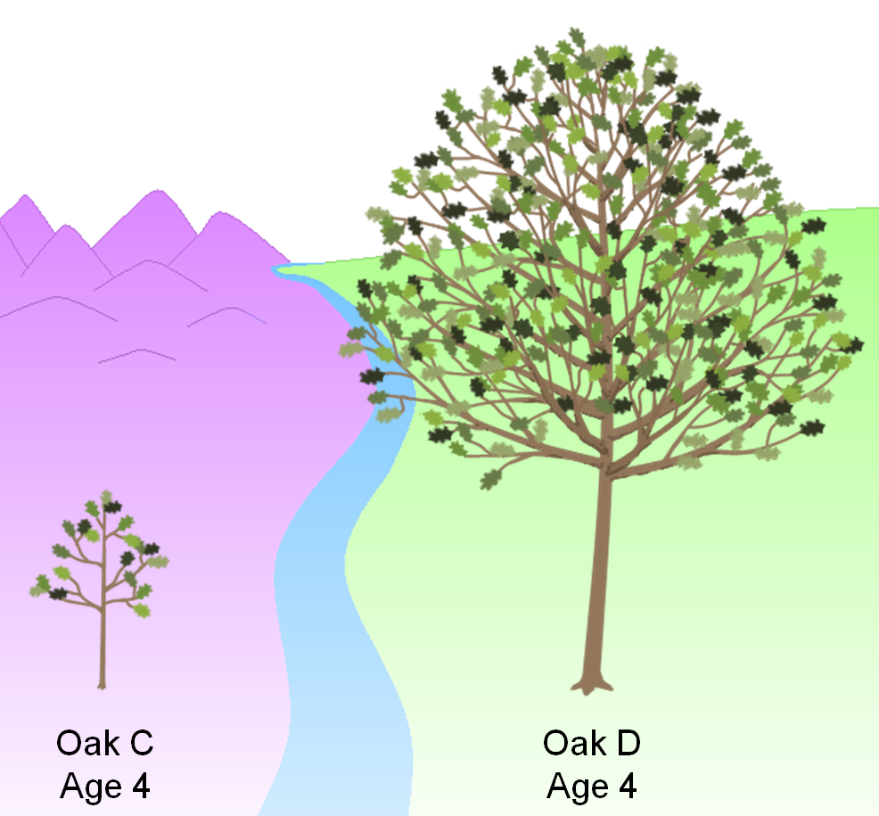
1. What about tall or short trees?
(High or low achieving students)

Slide 21
1. What about tall or short trees?
If we were using an Achievement Model, which gardener would you rather be?
How can we be fair to these gardeners in our Value-Added Model?
93 in.
Gardener C
Gardener D
28 in.
Oak C
Age 4
Oak D
Age 4
Notes:
In our analogy versus education context table, we mentioned prior tree height but did not go into details about this characteristic.
These two gardeners are about to care for these two trees for the next year.
If we were using an achievement model, which gardener would you rather be?
How can we be fair to these gardeners in our Value-Added model?

Slide 22
Why might short trees grow faster?
Why might tall trees grow faster?
More “room to grow”
Easier to have a “big impact”
Past pattern of growth will continue
Unmeasured environmental factors
How can we determine what is really happening?
Gardener C
Gardener D
Oak C
Age 4
Oak D
Age 4
Notes:
First of all, let’s think about whether tree height might have an effect on tree growth.
In general, why might short trees grow faster in the following year of gardener’s care?
Why might tall trees grow faster?
You can probably come up with some of your own guesses.
Some guesses we came up with for short trees are: shorter trees having more “room to grow” and that it might be easier for a gardener to have a “big impact” on the growth of that tree.
For tall trees, we guessed that tall trees have likely experienced a pattern of rapid growth in previous years, so this pattern might continue. In general, tall trees might be benefiting from some other environmental factor that we haven’t controlled for explicitly. This factor may benefit tall trees again next year.
These are all guesses about why gardeners with short trees or tall trees might be at an advantage. How can we determine what is really happening?

Slide 23
In the same way we measured the effect of rainfall, soil richness, and temperature, we can determine the effect of prior tree height on growth.
The Effect of Prior Tree Height on Growth
30 in
Growth from Year 4 to 5 (inches)
9 in
Oak C
(28 in)
Oak D
(93 in)
Prior Tree Height (Year 4 Height in Inches)
Notes:
In the same way we measured the effect of rainfall, soil richness, and temperature, we can determine the effect of prior tree height on growth.
We collect data on all Oak Trees in this specific region and measure whether short or tall trees grew faster.
In this case, we determine that tall trees tended to grow more.
In the earlier analogy, we assumed that all trees grew 20 inches during a year of care and then refined our predictions with each tree’s environmental conditions.
By including prior height in the model, we can improve our predictions by taking this data into account.
For example, before considering environmental conditions, Oak C with a starting height of 28 inches would be predicted to grow 9 inches. Oak D with a starting height of 93 inches would be predicted to grow 30 inches.

Slide 24
Our initial predictions now account for this trend in growth based on prior height.
The final predictions would also account for rainfall, soil richness, and temperature.
+30 in.
How can we accomplish this fairness factor in the education context?
+9 in.
Oak C
Age 4
Oak C
Age 5
(Prediction)
Oak D
Age 4
Oak D
Age 5
(Prediction)
Notes:
Our initial predictions now account for this trend in growth based on prior height.
The final predictions would also account for rainfall, soil richness, and temperature.
How can we accomplish this fairness factor in the education context?

Slide 25
Analyzing test score gain to be fair to teachers
df
Student | 3rd Grade Score | 4th Grade Score
Abbot, Tina | 244 | 279
Acosta, Lilly | 278 | 297
Adams, Daniel | 294 | 301
Adams, James | 275 | 290
Allen, Susan | 312 | 323
Alvarez, Jose | 301 | 313
Alvarez, Michelle | 256 | 285
Anderson, Chris | 259 | 277
Anderson, Laura | 304 | 317
Anderson, Steven | 288 | 308
Andrews, William | 238 | 271
Atkinson, Carol | 264 | 286
Test Score
Range
High
High
Achiever
Low
Low
Achiever
Notes:
Here we see 12 hypothetical students from a district.
For example,
Susan Allen scored very highly on her 3rd grade test, and highly again on her 4th grade test.
William Andrews had a very low score on both his 3rd grade and 4th grade tests.
A student’s skills and knowledge tend to persist from one year to the next. How can we use this information to make better predictions about student growth?

Slide 26
If we sort 3rd grade scores high to low, what do we notice about the students’ gain from test to test?
Student | 3rd Grade Score | 4th Grade Score | Gain in Score from 3rd to 4th
Allen, Susan | 312 | 323 | 11
Anderson, Laura | 304 | 317 | 13
Alvarez, Jose | 301 | 313 | 12
Adams, Daniel | 294 | 301 | 7
Anderson, Steven | 288 | 308 | 20
Acosta, Lilly | 278 | 297 | 19
Adams, James | 275 | 290 | 15
Atkinson, Carol | 264 | 286 | 22
Anderson, Chris | 259 | 277 | 18
Alvarez, Michelle | 256 | 285 | 29
Abbot, Tina | 244 | 279 | 35
Andrews, William | 238 | 271 | 33
Test Score
Range
High
Low
Notes:
If we sort 3rd grade scores high to low, what do we notice about students’ gain from test to test?
First we sort by each student’s 3rd Grade score.
We add a column that computes the gain in score from the 3rd grade to the 4th grade test.
For example, Susan Allen, our highest performing 3rd grader scored 312 on the 3rd grade test and 323 on the 4th grade test, a gain of 11 points.
William Andrews, our lowest performing 3rd grader scored 238 on the 3rd grade test and 271 on the 4th grade test, a gain of 33 points.
If we look at all this data together, do we notice a trend in the amount of gain students made based on their starting point on the 3rd grade test?

Slide 27
If we find a trend in score gain based on starting point, we control for it in the Value-Added model.
Student | 3rd Grade Score | 4th Grade Score | Gain in Score from 3rd to 4th
Allen, Susan | 312 | 323 | 11
Anderson, Laura | 304 | 317 | 13
Alvarez, Jose | 301 | 313 | 12
Adams, Daniel | 294 | 301 | 7
Anderson, Steven | 288 | 308 | 20
Acosta, Lilly | 278 | 297 | 19
Adams, James | 275 | 290 | 15
Atkinson, Carol | 264 | 286 | 22
Anderson, Chris | 259 | 277 | 18
Alvarez, Michelle | 256 | 285 | 29
Abbot, Tina | 244 | 279 | 35
Andrews, William | 238 | 271 | 33
Test Score
Range
High
Low
Gain
High
Low
Notes:
If we find a trend in score gain based on starting point, we control for it in the Value-Added model.
In this case, we see a trend that students with high scores in 3rd grade tended to gain fewer points on the 4th grade test.
Students with low score in 3rd grade tended to gain more points on 4th grade test.
Please note that this is a small subsection of students from multiple schools across the district or state. To make these kind of analyses, we use data from all students in the district or state to detect trends and patterns.
If we found that this pattern continued across an entire district or state, we would come to the conclusion that during this time period, students with low 3rd grade scores were more likely to gain more points on the 4th grade test than students starting off with high 3rd grade scores.
This is typically what we find when analyzing real test data. Higher achieving students tend to gain fewer points during a year of growth.
By measuring this trend and controlling for it when we make predictions, Value-Added Estimates can fairly compare the growth of students from across the achievement spectrum.

Slide 28
What do we usually find in reality?
Looking purely at a simple growth model, high achieving students tend to gain about 10% fewer points on the test than low achieving students.
In a Value-Added model we can take this into account in our predictions for your students, so their growth will be compared to similarly achieving students.
Notes:
Presenter notes:
Reasons this may be the case:
If student knowledge is not totally durable (learning is subject to decay would lead to lambda less than 1)
If school resources are allocated differently based on prior achievement (lambda less than 1 if more resources allocated to lower achievers, lambda greater than 1 if more resources allocated to higher achievers)
Different test scales used in pretest and posttest (lambda would partially reflect differences in scale)
If the relationship between post and prior achievement is nonlinear due to different methods used to scale assessments
From Meyer / Dokumaci Paper:
The model would be
simpler to estimate if it were appropriate to impose the parameter restriction λ =1, but there are at
least four factors that could make this restriction invalid. First, λ could be less than 1 if the stock of
knowledge, skill, and achievement captured by student assessments is not totally durable, but rather is
subject to decay. Second, λ could differ from 1 if school resources are allocated differentially to
students as a function of prior achievement. If resources were to be tilted relatively toward low achieving
students—a remediation strategy—then λ would be reduced. The opposite would be true if
resources were tilted toward high‐achieving students. Third, λ could differ from1 if posttest and pretest
scores are measured on different scales, perhaps because the assessments administered in different
grades are from different vendors and scored on different test scales or due to instability in the
variability of test scores across grades and years. In this case, the coefficient on prior achievement
partially reflects the difference in scale units between the pretest and posttest. Fourth, the different
methods used to scale assessments could in effect transform posttest and pretest scores so that the
relationship between post and prior achievement would be nonlinear. In this case a linear value‐added
model might still provide a reasonably accurate approximation of the achievement growth process, but
the coefficient on prior achievement (as in the case of the third point) would be affected by the test
scaling.

Slide 29
Comparisons of gain at different schools before controlling for prior performance
School A
School B
School C
Student
Population
Advanced
Proficient
Basic
Minimal
High
Achievement
Medium
Achievement
Low
Achievement
Why isn’t this fair?
Artificially lower gain
Artificially inflated gain
Notes:
Here we see three schools serving different student populations.
For example,
School A is serving mostly students with very high test scores.
On the other extreme, School C is serving mostly students with very low test scores.
Keep in mind what we just saw in the previous slide about district-wide or state-wide trends in gain on the test.
Why would it be unfair to compare of test score gain at different schools before controlling for prior performance?
In the previous slides, we saw that in this example test, students higher on the test scale tended to gain fewer points on average across the district.
If in reality School A, School B, and School C were all average at helping students learn, School C would look the best in a simple growth or gain model and School A would look the worst.
On average, students in the Minimal category would gain more points due to the uneven test scale we observed on the previous slide. That would make School C’s gains artificially inflated.
On average, students in the Advanced category would gain fewer points due to the uneven test scale. That would make School A’s gains artificially lower.

Slide 30
Comparisons of Value-Added at different schools after controlling for prior performance
School A
School B
School C
Student
Population
Advanced
Proficient
Basic
Minimal
Fair
Fair
Fair
Notes:
Since VARC analyzes the trend of scores for all student in the district or state, we can analyze these trends and determine the appropriate adjustments to counteract these effects in our predictions.
After we have made these customized predictions, we can fairly evaluate the growth of students in schools serving students with any achievement level distribution.
High Achieving students in School A are compared to typical growth for similar high achieving students from across the district or state.
Low Achieving students in School C are compared to typical growth for similar low achieving students from across the district or state.

Slide 31
Checking for Understanding
What would you tell a teacher or principal who said Value-Added was not fair to schools with:
High achieving students?
Low achieving students?
Is Value-Added incompatible with the notion of high expectations for all students?

Slide 32
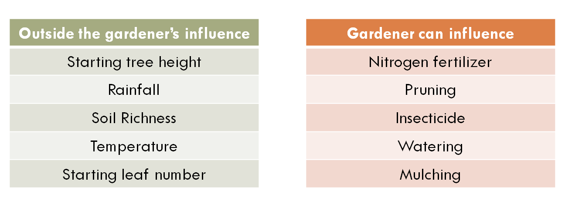
2. How does VARC choose what to control for?
(Proxy measures for causal factors)

Slide 33
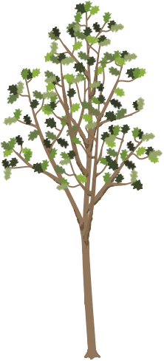
2. How does VARC choose what to control for?
Imagine we want to evaluate another pair of gardeners and we notice that there is something else different about their trees that we have not controlled for in the model.
In this example, Oak F has many more leaves than Oak E.
Is this something we could account for in our predictions?
73 in.
73 in.
Gardener E
Gardener F
Oak E
Age 5
Oak F
Age 5
Notes:
Imagine we want to evaluate another pair of gardeners and we notice that there is something else different about their trees that we have not controlled for in the model.
In this example, Oak F has many more leaves than Oak E.
Is this something we could account for in our predictions?

Slide 34
In order to be considered for inclusion in the Value-Added model, a characteristic must meet several requirements:
Check 1: Is this factor outside the gardener’s influence?
Check 2: Do we have reliable data?
Check 3: If not, can we pick up the effect by proxy?
Check 4: Does it increase the predictive power of the model?
Notes:
In order to be considered for inclusion in the Value-Added model, a characteristic must meet several requirements:
Check 1: Is this factor outside the gardener’s influence?
Check 2: Do we have reliable data?
Check 3: Can we approximate it with other data?
Check 4: Does it increase the predictive power of the model?

Slide 35
Check 1: Is this factor outside the gardener’s influence?
Outside the gardener’s influence
Starting tree height
Rainfall
Soil Richness
Temperature
Starting leaf number
Gardener can influence
Nitrogen fertilizer
Pruning
Insecticide
Watering
Mulching
Notes:
Check 1: Is this factor outside the gardener’s influence?
Here are some examples of categorized factors.
In a Value-Added model, we could potentially control for items in the green box.
Since the gardener could influence items in the red box, we would NOT want to control for them in the Value-Added model.

Slide 36
Check 2: Do we have reliable data?
Category | Measurement | Coverage
Yearly record of tree height | Height (Inches) | 100%
Rainfall | Rainfall (Inches) | 98%
Soil Richness | Plant Nutrients (PPM) | 96%
Temperature | Average Temperature (Degrees Celsius) | 100%
Starting leaf number | Individual Leaf Count | 7%
Canopy diameter | Diameter (Inches) | 97%
Notes:
Check 2: Do we have reliable data?
In 7% of cases, actual leaf number was recorded for trees. This is not enough to include this data in the Value-Added model.

Slide 37
Check 3: Can we approximate it with other data?
Category | Measurement | Coverage
Yearly record of tree height | Height (Inches) | 100%
Rainfall | Rainfall (Inches) | 98%
Soil Richness | Plant Nutrients (PPM) | 96%
Temperature | Average Temperature (Degrees Celsius) | 100%
Starting leaf number | Individual Leaf Count | 7%
Canopy diameter | Diameter (Inches) | 97%
?
Notes:
Check 3: Can we approximate it with other data?
It may be the case that canopy diameter could be used as a proxy for the real data we desire.

Slide 38
Canopy diameter as a proxy for leaf count
The data we do have available about canopy diameter might help us measure the effect of leaf number.
The canopy diameter might also be picking up other factors that may influence tree growth.
We will check its relationship to growth to determine if it is a candidate for inclusion in the model.
Gardener E
Gardener F
33 in.
55 in.
Oak E
Age 5
Oak F
Age 5
Notes:
The data we do have available about canopy diameter might help us measure the effect of leaf number.
Check 4 involves increasing the predictive power to the model.

Slide 39
If we find a relationship between starting tree diameter and growth, we would want to control for starting diameter in the Value-Added model.
The Effect of Tree Diameter on Growth
?
Growth from Year 5 to 6 (inches)
Tree Diameter (Year 5 Diameter in Inches)
Notes:
If we find a relationship between starting diameter and growth, we would want to control for starting diameter in the Value-Added model.
We might find that on its own, tree diameter does not have a clear effect on growth.

Slide 40
If we find a relationship between starting tree diameter and growth, we would want to control for starting diameter in the Value-Added model.
The Effect of Tree Diameter on Growth
Growth from Year 5 to 6 (inches)
Tree Diameter (Year 5 Diameter in Inches)
Notes:
We might find that tree diameter has a strong effect on growth.
If so, we would want to include starting tree diameter in our predictions to be fair to the gardeners.

Slide 41
What happens in the education context?
Check 1: Is this factor outside the school or teacher’s influence?
Check 2: Do we have reliable data?
Check 3: If not, can we pick up the effect by proxy?
Check 4: Does it increase the predictive power of the model?
Notes:
In order to be considered for inclusion in the Value-Added model, a characteristic must meet several requirements:
Check 1: Is this factor outside the gardener’s influence?
Check 2: Do we have reliable data?
Check 3: Can we approximate it with other data?
Check 4: Does it increase the predictive power of the model?

Slide 42
Check 1: Is this factor outside the school or teacher’s influence?
Outside the school’s influence
At home support
English language learner status
Gender
Household financial resources
Learning disability
Prior knowledge
School can influence
Curriculum
Classroom teacher
School culture
Math pull-out program at school
Structure of lessons in school
Safety at the school
Let’s use “Household financial resources” as an example
Notes:
Check 1: Is this factor outside the gardener’s influence?
Here are some examples of categorized factors.
In a Value-Added model, we could potentially control for items in the green box.
Since the school or teacher could influence items in the red box, we would NOT want to control for them in the Value-Added model.

Slide 43
Check 2: Do we have reliable data?
What we want
Household financial resources
Notes:
One example of a non-school factor we want to control for is household financial resources.
Ideally for our calculations, we would have a comprehensive list of resources available for each student.

Slide 44
Check 3: Can we approximate it with other data?
What we want
Household financial resources
What we have
Free / reduced lunch status
Related data
Using your knowledge of student learning, why might
“household financial resources” have an effect on student growth?
Check 4: “Does it increase the predictive power of the model?” will be determined by a multivariate linear regression model based on real data from your district or state (not pictured) to determine whether FRL status had an effect on student growth.
Notes:
Since that data is not available, we use what we do have as a substitute for our ideal data.
In most districts and states, we use eligibility for free and reduced lunch status.
This does not give us a complete picture of the financial resources available at a student’s household, but it is related data and is the best approximation we have available on the topic.
Using your knowledge of student learning, why might “household financial resources” have an effect on student growth?
Reasons we have heard from educators include:
Different access to technology, such as computers at home
Different likelihood to have external help available, such as paid tutoring services
Possible difference in parental availability for homework and study help due to multiple jobs
You can probably think of other reasons why household financial resources might affect student growth. Since these reasons are not something the school is responsible for, we want to remove the influence of this factor as best we can in order to fairly evaluate schools serving different student populations.
Check 4 would be based on a multivariate linear regression model to determine whether FRL status had an effect on student growth in your district or state.
If we find a district-wide or state-wide difference in growth trend based on financial resources, we can customized our predicted outcomes for students based on this characteristic.
LIVE PRESENTER NOTES:
Some possible talking points on the question:
Doug Harris’s book points (summer learning loss, etc.)
From Doug Harris Book:
“Should value-added models take into account student race,
income, and other student factors in estimating value-added?
This is one of the more controversial questions in using value-added for
accountability. In one respect, the issue boils down to whether taking
into account prior achievement is enough. Race, ethnicity, and
income are after all closely related to student attainment on test scores
(see Figure 1.1). But it turns out that these factors are less closely
related to achievement growth.
The reason for this should be intuitive: if student demographics
are associated with achievement in every grade, then the association
should largely “cancel out” when subtracting the two. Here is a
simple, concrete example to highlight this: Suppose that a student
scored 60 points in one year and 80 points in the next year and grade,
for growth of 20 points. Now, suppose that part of the reason
explaining these scores is that fact that the students’ parents do not
make sure the child does her homework each night (in all years). This
might reduce the student’s score by 5 points in each year from what it
would have been. So, the student would have scored 65 and 85
(instead of 60 and 8) if the student had done her homework. Notice
that the growth is exactly the same in both cases—20 points. So long
as the influence on student scores is constant over time, the influence
on scores should cancel out in this way.
But minority and low-income students do still learn at slower
rates. One study finds that while most of the gap by family income
exists in 1st grade, it grows by about 30 percent between 1st and 5th
grade.1 Almost all of this, in turn is due, not to what happens in
school, but to the “summer learning loss,” the period between school
years when students are not in school. This is most likely because
the same factors creating the starting gate inequalities also affect
learning growth. Because standardized tests are not administered at
the beginning of the school year, the summer learning loss is
embedded within the student growth measures. Further, the summer
learning loss is substantially outside the control of schools and
therefore problematic. An accurate measure of value-added must take
into account all of the factors outside their control.
The concern with accounting for race and income, however, is
that some see it as reducing expectations for these students. There
are legitimate differences of opinion on this point, but let me clarify
the two different meanings of “lower expectations.” On the one hand,
this could mean that accounting for race and income means that
schools can get by giving less effort to raise achievement for
disadvantaged students. Value-added measures that account for race
and income do not lower expectations in this sense. In fact, the whole
point of value-added is to create an even playing field and one that
provides incentives for schools to help all students.
Alternatively, some interpret “lower expectations” to mean that
schools serving disadvantaged students will have the same measured
performance as schools serving advantaged students while generating
less student learning. If this is what is meant by lower expectations,
then it is a legitimate point. Value-added models that adjust
predictions based on student race and income do require less learning
of disadvantaged students to reach the same level of school
performance. Again, this just reflects the fact that schools should not
be held accountable for factors outside their control and students’
home environments and other factors affecting students clearly fall
into that category.
There is some potential middle ground on this issue. If the
concern is about how much emphasis schools place on achievement of
different groups, value-added measures can be designed to place as
much or as little weight on disadvantaged students as we wish. For
example, we could design the accountability system so that 10 points
in growth for a low-income student counts twice as much as for a
high-income student. Also, when statisticians estimate value-added,
they also end up estimating the statistical relationship (correlation)
between student race and income and student achievement growth
(see Oakville example above). Districts could use the measured role of
student disadvantage as an indicator of how well the district is doing
to overcome racial and income achievement gaps.2 If socio-economic
disadvantage is associated with lower growth, then this might
motivate districts to try even harder to address the issue. That is,
rather than lowering expectations, it can be a driver of higher
expectations and even greater effort for those students.
It is also worth recalling that value-added measures can help
reduce the problem of driving out teachers of low-attainment schools.
The same goes for disadvantaged students. To the degree that
student race and income are associated with their achievement
growth, failing to account for those factors will place the teachers of
those students at a disadvantage.
In my view, it is best to account for student race and income
when predicting each school’s achievement. The reason comes back
to the Cardinal Rule: Hold people accountable for what they can
control. While this means that schools serving disadvantaged
students will receive higher performance ratings with less growth, it
does not mean that schools can get by with giving less effort to these
students. If, in addition, we give disproportionate weight to the
growth of racial minorities and low-income students, and use the
statistical relationship between student disadvantage and student
achievement growth as a motivation to address the gap, then
accounting for student disadvantage would seems to raise
expectations—and outcomes—for these students rather than lower
them. I cannot prove that, unfortunately, but there is a strong
rationale behind it.”

Slide 45
What about race/ethnicity?
Race/ethnicity causes higher or lower performance
What we want
General socio-economic status
Family structure
Family education
Social capital
Environmental stress
What we have
Race/ethnicity
Related complementary data may correlate with one another
(not a causal relationship)
Check 4 will use real data from your district or state to determine if race/ethnicity has an effect on student growth.
If there is no effect, it will not be included in the model.
Notes:
What about race and ethnicity?
One of the pieces of data often collected is student race and ethnicity.
Why might we include this in the model?
Rather than a causal relationship between race and student growth, it might be the case that race/ethnicity is picking up the effect of factors like general socio-economic status, family structure, family education, social capital, and environmental stress.
This will not always be the case for every student, but it may be true across entire districts or states.
During check 4, VARC uses real data from your district or state to determine if race/ethnicity has an effect on student growth.
If there is no effect, it will not be included in the model

Slide 46
What about race/ethnicity?
If there is a detectable difference in growth rates
We attribute this to a district or state challenge to be addressed
Not as something an individual teacher or school should be expected to overcome on their own
Notes:
If there is a detectable difference in growth rates of different groups of students, we attribute this to a district or state challenge to be addressed, not something an individual teacher or school should be expected to overcome on their own. If a particular school, grade-level team, or teacher is making above-average results with any group of students, this will be reflected in an above-average Value-Added estimate.
By using all the data we have available, we try to get the most complete picture of the real situations of students to make our predictions as accurate as possible. The more complete job VARC can do at controlling for external factors, the more accurate we can be about evaluating the effect of districts, schools, grades, classrooms, programs, and interventions.

Slide 47
Checking for Understanding
What would you tell a 5th grade teacher who said they wanted to include the following in the Value-Added model for their results?:
5th grade reading curriculum
Their students’ attendance during 5th grade
Their students’ prior attendance during 4th grade
Student motivation
Check 1: Is this factor outside the school or teacher’s influence?
Check 2: Do we have reliable data?
Check 3: If not, can we pick up the effect by proxy?
Check 4: Does it increase the predictive power of the model?

Slide 48
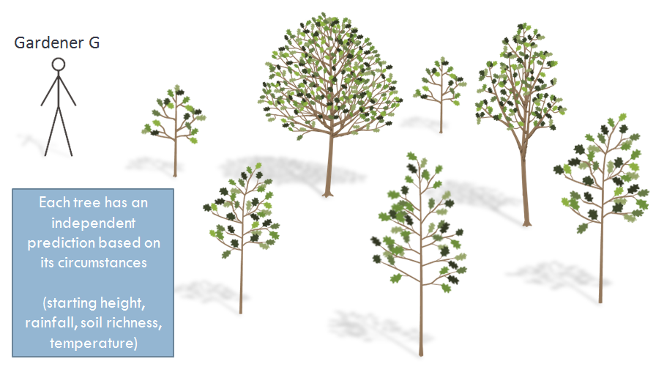
3. What if a gardener just gets lucky or unlucky?
(Groups of students and confidence intervals)

Slide 49
3. What if a gardener just gets lucky or unlucky?
Gardener G
Oak A predicted growth:
10 inches
Oak A
Age 3
(1 year ago)
Predicted
Oak A
Notes:
What if a gardener just gets lucky or unlucky?
Based on all available data for Oak A, we predict that by the end of the year, Oak A will grow 10 inches.

Slide 50
Gardener G
Oak A actual growth:
2 inches
For an individual tree, our predictions do not account for random events.
Oak A
Age 3
(1 year ago)
Actual
Oak A
Notes:
But there are limits to what our predictions can tell us.
For an individual tree, our predictions do not account for random events.

Slide 51
Gardeners are assigned to many trees
Gardener G
Each tree has an independent prediction based on its circumstances
(starting height, rainfall, soil richness, temperature)
Notes:
In the oak tree analogy, we have been considering a single tree for each gardener.
To be a more accurate portrayal of how Value-Added works, gardeners would be assigned to many trees.
Each of the gardener’s trees has an independent set of circumstances (prior height, rainfall, etc.), so the prediction for each tree will be customized for its own situation.

Slide 52
How confident would you be about the effect of these gardeners?
Gardener G
Total trees assigned
5
Trees that missed predicted growth
3
Trees that beat predicted growth
2
Due to unlucky year
2
Due to gardener
1
Due to gardener
2
Due to lucky year
0
Gardener H
Total trees assigned
50
Trees that missed predicted growth
30
Trees that beat predicted growth
20
Due to unlucky year
7
Due to gardener
23
Due to gardener
15
Due to lucky year
5
Notes:
A Value-Added estimate represents the average effect of the gardener on this group of assigned trees.
Since individual trees could have a lucky or unlucky year, the more trees a gardener is assigned to, the more sure we can be about the effect of the gardener.

Slide 53
Reporting Value-Added
In the latest generation of Value-Added reports, estimates are color coded based on statistical significance. This represents how confident we are about the effect of schools and teachers on student academic growth.
Green and Blue results are areas of relative strength.
Student growth is above average.
Gray results are on track. In these areas, there was not enough data available to differentiate this result from average.
Yellow and Red results are areas of relative weakness.
Student growth is below average.

Slide 54
3
Numbers lower than 3.0 represent growth that did not meet prediction.
Students are still learning, but at a rate slower than predicted.
3.0 represents meeting predicted growth for your students.
Since predictions are based on the actual performance of students in your state, 3.0 also represents the state average growth for students similar to yours.
Numbers higher than 3.0 represent growth that beat prediction.
Students are learning at a rate faster than predicted.
Value-Added is displayed on a
1-5 scale for reporting purposes.
About 95% of estimates will fall between 1 and 5 on the scale.
Grade 4
30

Slide 55
3
READING
Grade 4
30
3.8
95% Confidence Interval
Value-Added estimates are provided with a confidence interval.
Based on the data available for these thirty 4th Grade Reading students, we are 95% confident that the true Value-Added lies between the endpoints of this confidence interval (between 3.2 and 4.4 in this example), with the most likely estimate being 3.8.

Slide 56
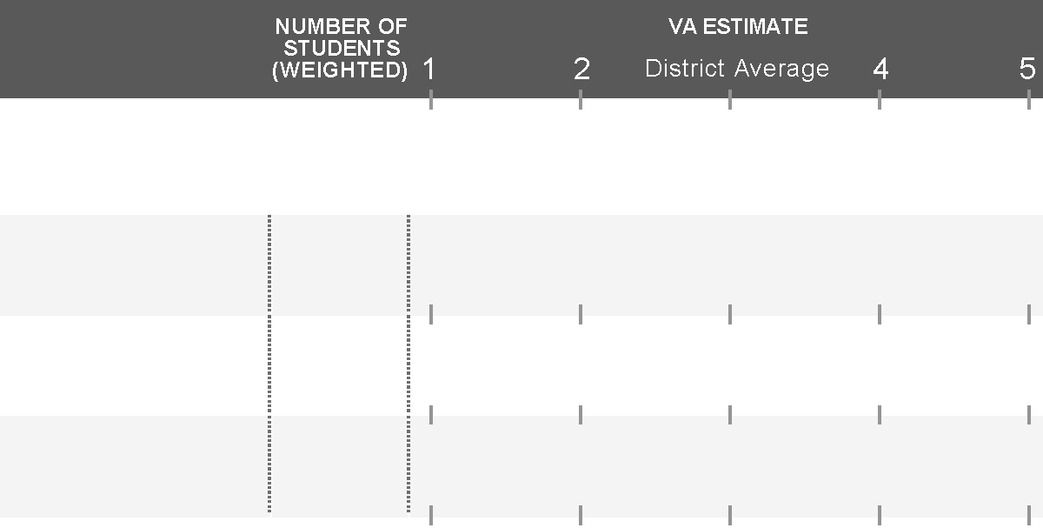
Confidence Intervals
Color coding is based on the location of the confidence interval.
The more student data available for analysis, the more confident we can be that growth trends were caused by the teacher or school (rather than random events).
3
READING
Grade 3
13
4.5
Grade 4
36
4.5
Grade 5
84
4.5
3
MATH
Grade 3
13
1.5
Grade 4
36
1.5
Grade 5
84
1.5

Slide 57
Checking for Understanding
A teacher comes to you with their Value-Added report wondering why it’s not a green or blue result.
She wants to know why there’s a confidence interval at all when VARC had data from each and every one of her students. (Don’t we know exactly how much they grew?)
3
READING
Grade 7
11
4.2

Slide 58
Break

Slide 59
Report Interpretation and Decision Making
Sean McLaughlin

Slide 60
Report Interpretation and Decision Making
3
MATH
Grade 4
30
1.3
Grade 5
30
2.5
Overall
60
1.9

Slide 61
Report Interpretation and Decision Making
3
READING
Grade 4
30
2.7
95% Confidence Interval
Value-Added estimates are provided with a confidence interval.
Based on the data available for these thirty 4th Grade Reading students, we are 95% confident that the true Value-Added lies between the endpoints of this confidence interval (between 2.1 and 3.3 in this example), with the most likely estimate being 2.7

Slide 62
Value-Added Color Coding
3
READING
Grade 4
30
3.0
Grade 5
30
2.5
Grade 6
15
4.1
If the confidence interval crosses 3, the color is gray.

Slide 63
Value-Added Color Coding
3
READING
Grade 4
30
3.7
Grade 5
30
4.1
Grade 6
15
4.4
If the entire confidence interval is above 3, the color is green.

Slide 64
Value-Added Color Coding
3
READING
Grade 4
30
4.6
Grade 5
30
5.1
Grade 6
15
5.3
If the entire confidence interval is above 4, the color is blue.

Slide 65
Value-Added Color Coding
3
READING
Grade 4
30
2.3
Grade 5
30
1.8
Grade 6
15
1.3
If the entire confidence interval is below 3, the color is yellow.

Slide 66
Value-Added Color Coding
3
READING
Grade 4
30
1.3
Grade 5
30
0.8
Grade 6
15
0.3
If the entire confidence interval is below 2, the color is red.

Slide 67
Value-Added Color Coding
These colors are meant to categorize results at a glance, but making responsible decisions based on Value-Added estimates may require more careful use of the data.
General guidelines:
Green and Blue results are areas of relative strength. Student growth is above average.
Gray results are on track. In these areas, there was not enough data available to differentiate this result from average.
Yellow and Red results are areas of relative weakness. Student growth is below average.

Slide 68
Explain to your Neighbor
Which grade-level team is most effective at growing their students?
Can we tell which group of students has the highest proficiency rate?
3
MATH
Grade 3
64
1.9
Grade 4
67
4.2
Grade 5
59
2.7
If this was your school, how would you start talking about this data with your teaching teams?

Slide 69
Decision Making Examples
To put this into context, let’s go through a few examples of decisions a school leader might make based on Value-Added results.
Which grade-level teams should get additional help from a literacy coach?
How might we pair up teaching teams in mentor relationships?
When should I look outside my school for help at improving student learning?
How can I prioritize resources if my results unclear?
How do I interpret gray results, and what can I learn from them?
Should I recommend professional development or a change in curriculum to particular teams?
Is Value-Added telling me a particular team is ineffective at teaching?

Slide 70
1. Which grade-level teams should get additional help from a literacy coach?
3
READING
Grade 3
25
3.0
Grade 4
26
3.9
Grade 5
28
1.8

Slide 71
1. Which grade-level teams should get additional help from a literacy coach?
3
READING
2nd Priority
Grade 3
25
3.0
3rd Priority
Grade 4
26
3.9
1st Priority
Grade 5
28
1.8
This is a relatively low-stakes decision.
A literacy coach may be beneficial to any of these teams. There is little risk in providing this resource to all the teachers.
The limiting factor is likely to be availability of this resource. If possible, provide it to all teachers, but limited allocation may be based on area of most need.

Slide 72
2. How might we pair up teaching teams in mentor relationships?
3
MATH
Grade 3
27
3.4
Grade 4
29
1.8
Grade 5
30
4.1

Slide 73
2. How might we pair up teaching teams in mentor relationships?
3
MATH
Grade 3
27
3.4
Pair with Grade 5
Grade 4
29
1.8
Pair with Grade 4
Grade 5
30
4.1
Pairing up teaching teams with relative strengths with those of relative weaknesses may help your school’s ability to meet the needs of all students.
In this case, grade 5 seems to be the strongest performer in math. If faced with a similar student population, the grade 4 team may be able to strategize with the grade 5 team to make more academic growth with the 4th grade students.
If 3rd grade’s student population was more similar, this would be another pairing option.

Slide 74
3. When should I look outside my school for help at improving student learning?
3
READING
Grade 3
39
1.9
Grade 4
42
0.8
Grade 5
38
1.3

Slide 75
3. When should I look outside my school for help at improving student learning?
3
READING
Grade 3
39
1.9
Grade 4
42
0.8
Grade 5
38
1.3
In this situation, it appears that each of the three reading grade-level teams at this school is producing below-average growth with their students.
This would be a good opportunity to seek out high performing teachers and grade-level teams in other schools in the same grade level throughout the district or state. Try to find schools serving students with similar achievement levels and other characteristics to maximize the chance that their high Value-Added strategies will be applicable to your students.

Slide 76
4. How can I prioritize resources if my value-added results are unclear?
Past Academic Year
3
READING
-
Grade 5
Insufficient Data
Grade 6
2.3
35
13
1.7
Grade 7
If you could only provide a teaching coach to one grade at your school, which one would you choose?

Slide 77
4. How can I prioritize resources if my value-added results are unclear?
Past Academic Year
3
READING
?
-
Grade 5
Insufficient Data
Grade 6
2.3
35
13
1.7
Grade 7
If you could only provide a teaching coach to one grade at your school, which one would you choose?
Grade 5 has no information at all here.
Grade 6 is yellow (below predicted), but just barely.
Grade 7’s best estimate is 1.7, lower than Grade 6. However, the color is gray due to a large confidence interval based on very few students (only 13).
In cases like this, it is very important to look at other data. Let’s add in the Value-Added 3 year average to try to better understand the situation.

Slide 78
4. How can I prioritize resources if my value-added results are unclear?
Past Academic Year
3-Year Average
3
3
READING
-
4.2
Grade 5
Insufficient Data
23
Grade 6
2.3
1.9
35
105
13
1.7
3.1
Grade 7
43
If you could only provide a teaching coach to one grade at your school, which one would you choose?

Slide 79
4. How can I prioritize resources if my value-added results are unclear?
Past Academic Year
3-Year Average
3
3
READING
-
4.2
Grade 5
Insufficient Data
23
Grade 6
2.3
1.9
35
105
13
1.7
3.1
Grade 7
43
By considering the 3 year average, we can conclude:
The 5th grade team has a history of above average growth.
The 6th grade team is consistently producing below average student growth.
The 7th grade team seems to be on track now that we can see the historic data based on more students (43 instead of just 13).
The 6th grade team might benefit the most from the teaching coach. As always, consider context and other data. For example, do these teams have different class sizes, or is this just a difference in number of teachers / classrooms per grade?

Slide 80
5. How do I interpret gray results, and what can I learn from them?
3
READING
These three teams each have gray estimates.
Would you interpret them the same way?
Grade 3
52
2.9
Grade 4
12
4.7
Grade 5
19
3.1

Slide 81
5. How do I interpret gray results, and what can I learn from them?
3
READING
These three teams each have gray estimates.
Would you interpret them the same way?
Grade 3
52
2.9
Grade 4
12
4.7
Grade 5
19
3.1
Grade 3 – The tight confidence interval around the gray estimate indicates we can be confident that this team’s Value-Added was close to average.
Grade 4 – The best estimate of Value-Added is above average (4.7). However, since it was based on a small amount of data (12 students), we cannot say with confidence that it was above average. This team may actually have below average Value-Added.
Grade 5 – The best estimate is average Value-Added (3.1). However, the wide confidence interval indicates that there was not enough data to rule out above or below average Value-Added.

Slide 82
5. How do I interpret gray results, and what can I learn from them?
3
READING
These three teams each have gray estimates.
Would you interpret them the same way?
Grade 3
52
2.9
Grade 4
12
4.7
Grade 5
19
3.1
As always, consider multiple data sources when making decisions.
The 3rd grade team has the most certain Value-Added estimate can be treated as one of the average teaching teams in the state.
The 4th and 5th grade teams have less certain estimates and it is particularly important that additional sources of information are considered before making decisions about professional development, resource allocation, staffing assignments, etc.

Slide 83
6. Should I recommend professional development or a change in curriculum to particular teams?
3
MATH
Grade 3
41
2.9
Grade 4
42
1.1
Grade 5
44
3.6

Slide 84
6. Should I recommend professional development or a change in curriculum to particular teams?
3
MATH
Grade 3
41
2.9
?
1.1
Investigate
Grade 4
42
Grade 5
44
3.6
A below average Value-Added estimate for the 4th grade teams indicates that during this past year, 4th grade students at your school grew slower than predicted.
Use other information and meet with this teaching team to determine root causes of this result. Is this a new content or grade area for one or more teachers on this team? Was there a particular challenge that this team faced last year?
Work with the teachers to come up with a goal and plan for next year’s students. Consider instructional changes, classroom management, mentoring, standards focus, etc.

Slide 85
7. Is Value-Added telling me a particular team is ineffective at teaching?
Past Academic Year
3-Year Average
3
3
READING
36
3.4
3.2
Grade 5
101
Grade 6
1.2
0.9
36
100
35
0.7
2.8
Grade 7
98

Slide 86
7. Is Value-Added telling me a particular team is ineffective at teaching?
Past Academic Year
3-Year Average
3
3
READING
36
3.4
3.2
Grade 5
101
?
Investigate
Grade 6
1.2
0.9
36
100
35
0.7
2.8
Grade 7
98
The 7th grade team had the lowest Value-Added this year, but considering the 3-Year Average, this seems to be isolated to just the last year. Work with these teachers to determine why results may have been lower than usual last year.
More concerning is 6th grade Value-Added. Not only is last year’s performance low, but it has been consistently low over the 3-Year Average. Consider what else you know about these teachers from observations and other data. Does Value-Added fit with a pattern of data showing low performance for this team? How might you and your school best support the 6th grade team next year?

Slide 87
District Decision Making Examples
What are potential district level decisions with current results?
Are there particular schools or groups of schools that require more support?
Are there trends based on particular challenges schools face?
Are there schools that “beat the odds”? How can we capitalize on their success?
How can we respond with resources, programs, and support structures?
Is there an overall weakness or strength in our teachers for a particular subjects?
How do we respond as a district?

Slide 88
How to Read the Scatter Plots
100
These scatter plots are a way to represent Achievement and Value-Added together
Achievement
80
60
Percent Prof/Adv (2009)
Value-Added
40
20
0
1
2
3
4
5
Value-Added (2009-2010)

Slide 89
How to Read the Scatter Plots
A. Students know a lot and are growing faster than predicted
100
C
A
B. Students are behind, but are growing faster than predicted
80
E
C. Students know a lot, but are growing slower than predicted
60
Percent Prof/Adv (2009)
B
D. Students are behind, and are growing slower than predicted
40
D
E. Students are about average in how much they know and how fast they are growing
20
0
1
2
3
4
5
Schools in your district
Value-Added (2009-2010)

Slide 90
1. Are there particular schools or groups of schools that require more support?
READING
Scenario 1
(relatively low-achieving district)
100
Are there trends based on particular challenges schools face?
Are there schools that “beat the odds”? How can we capitalize on their success?
How can we respond with resources, programs, and support structures?
80
60
READING Percent Prof/Adv (2009)
40
20
Schools in your district
0
Schools in the state
1
2
3
4
5
READING Value-Added (2009-2010)

Slide 91
1. Are there particular schools or groups of schools that require more support?
READING
Scenario 1
(relatively low-achieving district)
100
What strategies are schools in group A using to meet the needs of low achieving students?
Can we replicate this success in group B?
Are there strategies our district can use to facilitate this improvement?
80
60
B
READING Percent Prof/Adv (2009)
40
A
20
0
1
2
3
4
5
READING Value-Added (2009-2010)

Slide 92
1. Are there particular schools or groups of schools that require more support?
MATH Grade 4
Scenario 2
(relatively high-achieving district)
100
80
60
MATH Percent Prof/Adv (2009)
40
20
Schools in your district
0
Schools in the state
1
2
3
4
5
Grade 4 MATH Value-Added (2009-2010)

Slide 93
1. Are there particular schools or groups of schools that require more support?
MATH Grade 4
Scenario 2
(relatively high-achieving district)
100
C
D
What would you tell a principal in group C who said their Value-Added was low because their students had no room to grow on the test?
How can we learn from the success of group D and bring that knowledge to group C?
Are there programs or resources that group D is receiving that we could also provide to group C?
80
60
MATH Percent Prof/Adv (2009)
40
20
0
1
2
3
4
5
Grade 4 MATH Value-Added (2009-2010)
Notes:
In the first section, we had an example where we paired teaching teams across grade levels at a school (Grade 5 Math pairing with teachers at the same school in Grade 4 to try to improve Grade 4 Value-Added).
If this wasn’t working to improve results, we might look at other schools across the district who are having greater success in Grade 4 Math.

Slide 94
2. Is there an overall weakness or strength in our teachers for a particular subjects?
READING Grade 5
Scenario 3
(Consistently low Value-Added)
100
How can we respond as a District?
80
60
READING Percent Prof/Adv (2009)
40
20
Schools in your district
0
Schools in the state
1
2
3
4
5
Grade 5 READING Value-Added (2009-2010)

Slide 95
2. Is there an overall weakness or strength in our teachers for a particular subjects?
READING Grade 5
Scenario 3
(Consistently low Value-Added)
100
Can we connect to other districts across the state to collaborate?
Are some of our Network partners getting high Value-Added estimates? How can we learn from their success?
80
60
E
READING Percent Prof/Adv (2009)
40
20
0
1
2
3
4
5
Grade 5 READING Value-Added (2009-2010)

Slide 96
Sample Report Review
Ernest Morgan, Clarissa Steele

Slide 97
Concepts We Will Model
Relative nature of Value-Added
1-5 scale (tier units)
Confidence intervals
Number of students
School-level vs. grade-level estimates
1-year vs. 3-year average
Power of two (VA and Achievement)

Slide 98
Page 1
Reporting Period and Context
Table of Contents
Color Coding Explanation

Slide 99
Page 2
School-Level Value-Added Estimates
Grade-Level Value-Added Estimates

Slide 100
Page 2 Top

Slide 101
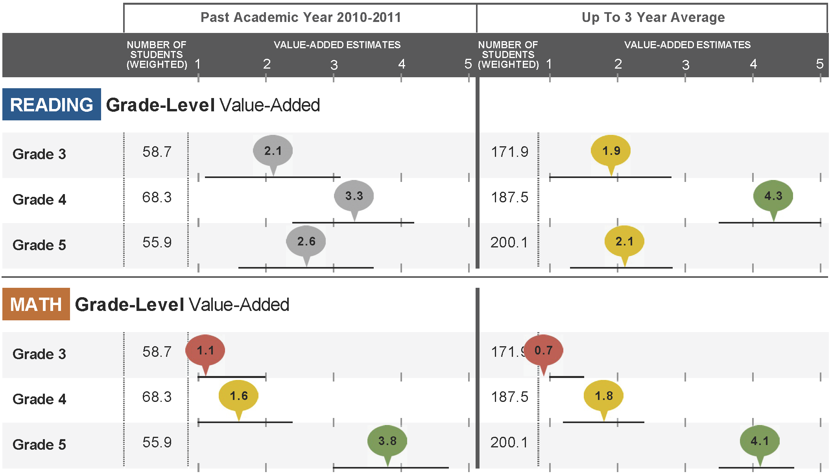
Page 2 Bottom

Slide 102
Page 3
School-Level Value-Added and Achievement
Scatter Plot Interpretation

Slide 103
Page 3 Scatter Plots

Slide 104
Page 4 (or 4 & 5 for large grade span schools)
Grade-Level Value-Added and Achievement

Slide 105
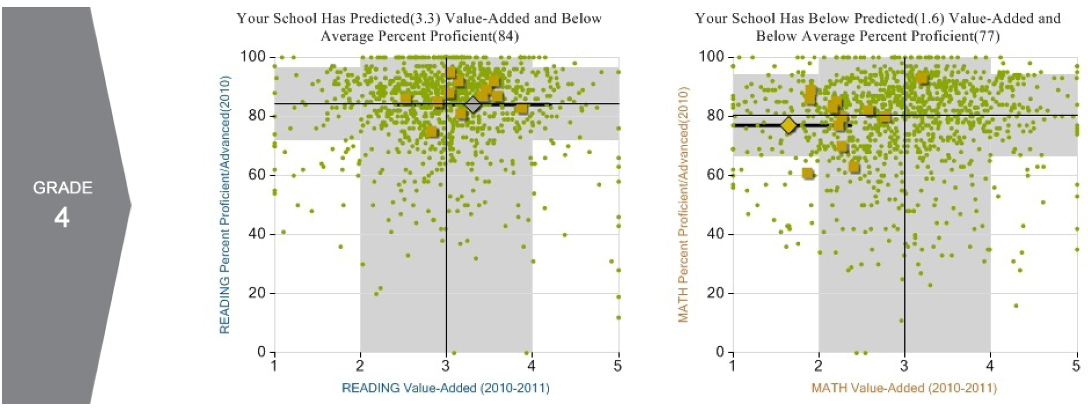
Page 4 Example (Grade 4)

Slide 106
Last Page
1-5
Value-Added Scale
Number of Students (Weighted)
Control Variables in the Model

Slide 107
Your Turn - Sample Report Review
Relative nature of Value-Added
1-5 scale (tier units)
Confidence intervals
Number of students
School-level vs. grade-level estimates
1-year vs. 3-year average
Power of two (VA and Achievement)

Slide 108
What Other Questions Came Up?

Slide 109
Implications for CESAs
How can you envision presenting Value-Added reports?
Single school, single district, multiple district
Teachers, principals, district staff
What additional resources do you desire?
Suggested agenda?
PowerPoint presentations?
Online course?
FAQs?

Slide 110
Summary of Resources
The Oak Tree Analogy (30 minutes)
The concept of Value-Added analysis
Education Based Examples (30 minutes)
Attainment to gain to growth to Value-Added
The Oak Tree Analogy Additions (60 minutes)
Three FAQs addressed with small group discussion
Value-Added Report Interpretation and Decision Making (60 minutes)
Color coding of estimates and example decisions
Value-Added Online Course (self-paced ~2 hours)

Slide 111
Final Questions and Wrap-Up
What are our next steps?
How can VARC support your work?

